Slide 1
Learning from Architecture--
Information inquiry on architectural history
Chen-shan Wang
University of Pennsylvania

Slide 2
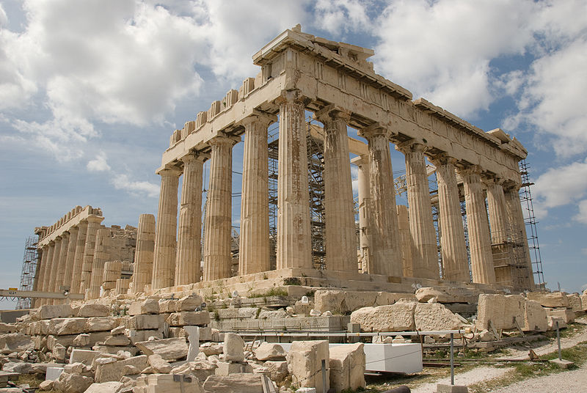
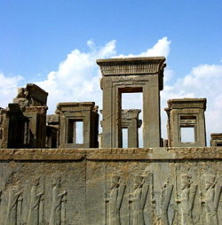
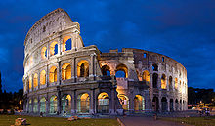
Architectural history and Art history
Art history has historically been understood as the academic study of objects of art in their historical development and stylistic contexts, i.e. genre, design, format, and look. This includes the "major" arts of painting, sculpture, and architecture as well as the "minor" arts of ceramics, furniture, and other decorative objects.
Scholarship: Architecture, Regional studies, Archaeology, Landscape
architecture, Historic preservation, etc
Historic Preservation: Documentation and Conservation
(applied science)

Slide 3
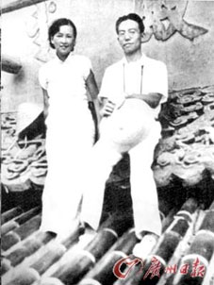
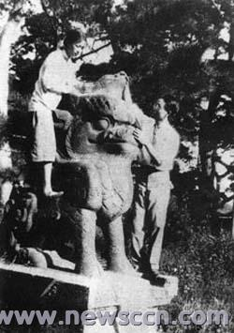
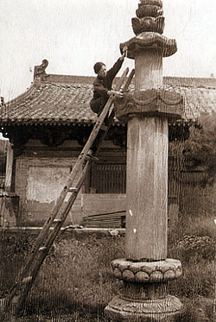
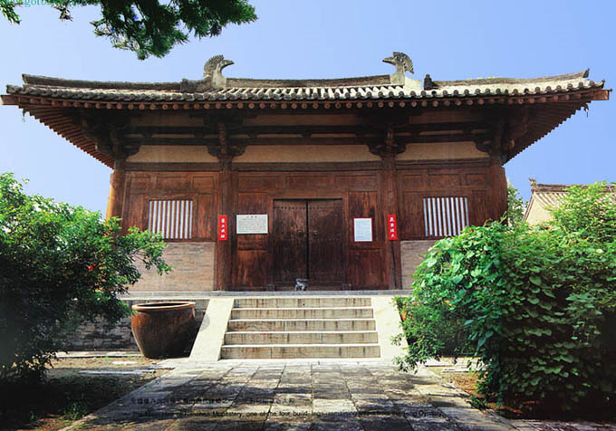
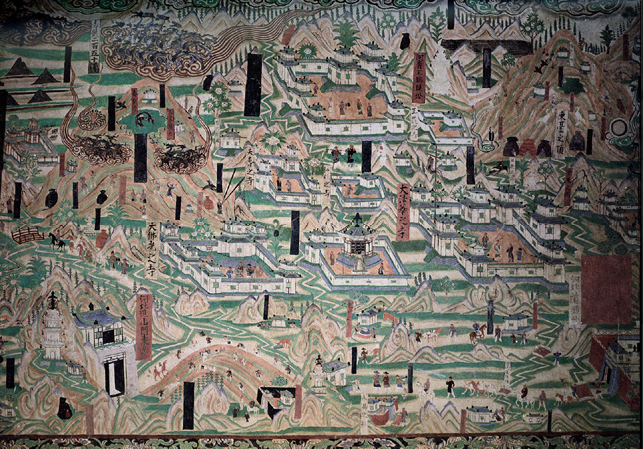
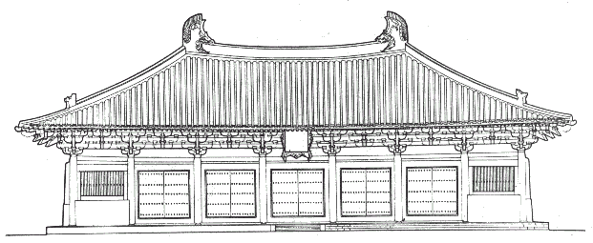
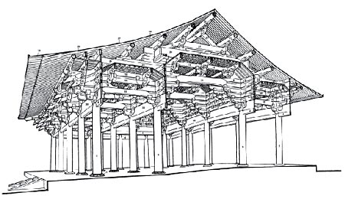
What do architectural historians do?
Architecture profession: Design, Engineering and History/Theory
Nanchan temple
Foguang temple

Slide 4
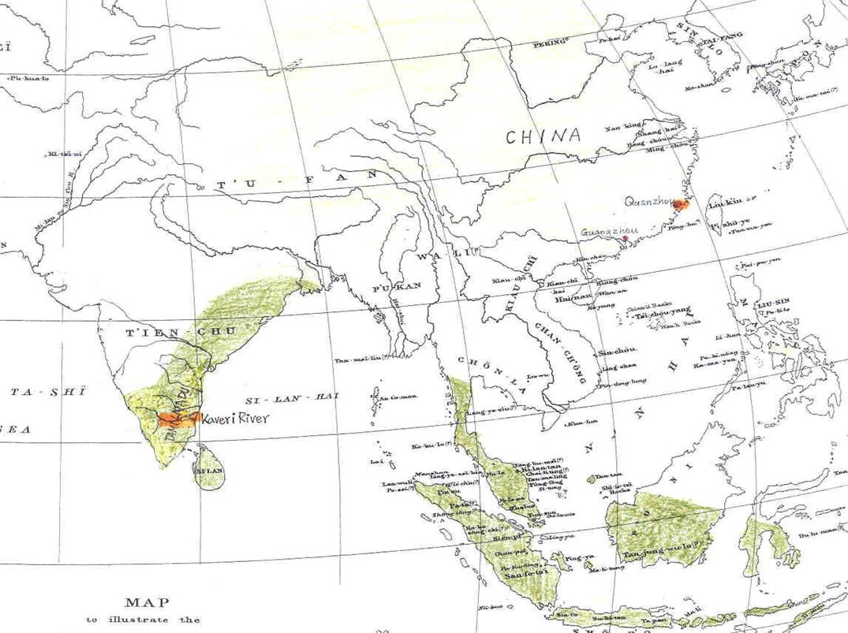
Example 1. Brahmanical Temple in Quanzhou, China
Background : components of Brahmanical/Hindu temples (Śiva and Visnu) found in Quanzhou
Research subjects: Maritime trade history and Multicultural studies
Notes:
我的博士論文

Slide 5
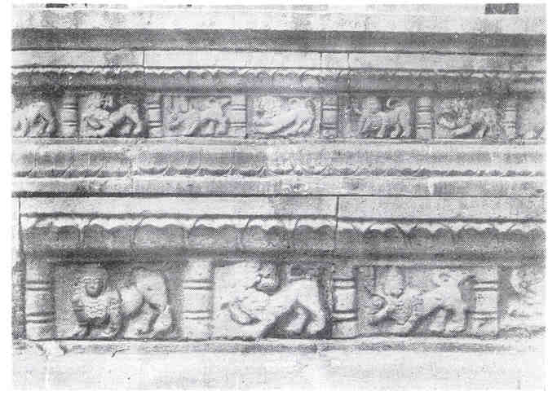
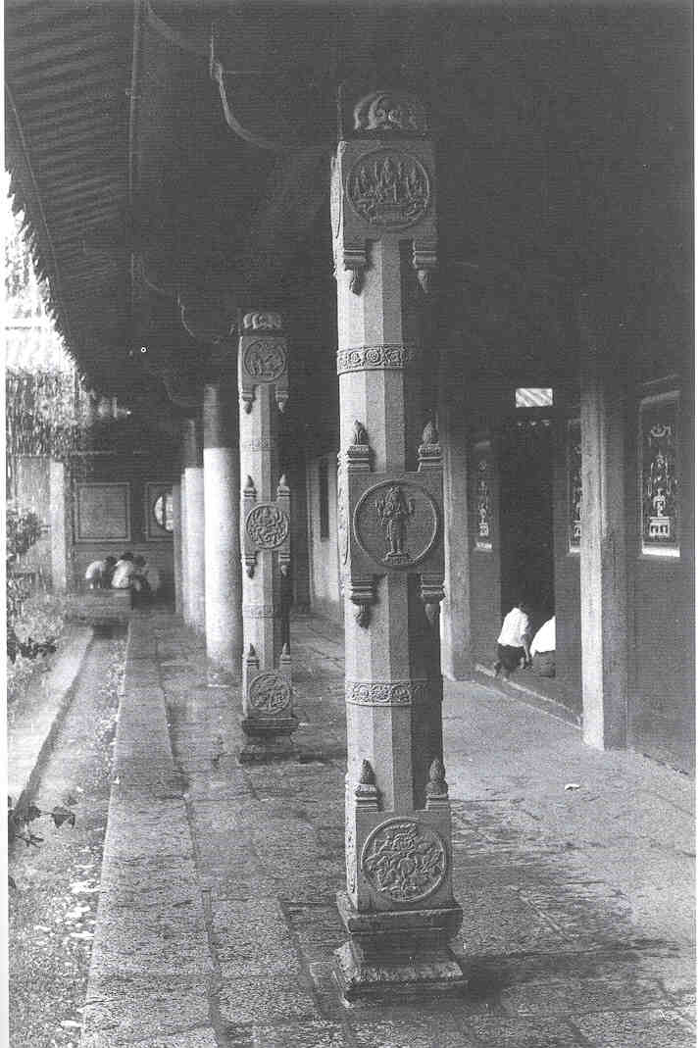
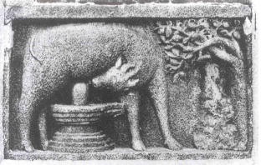
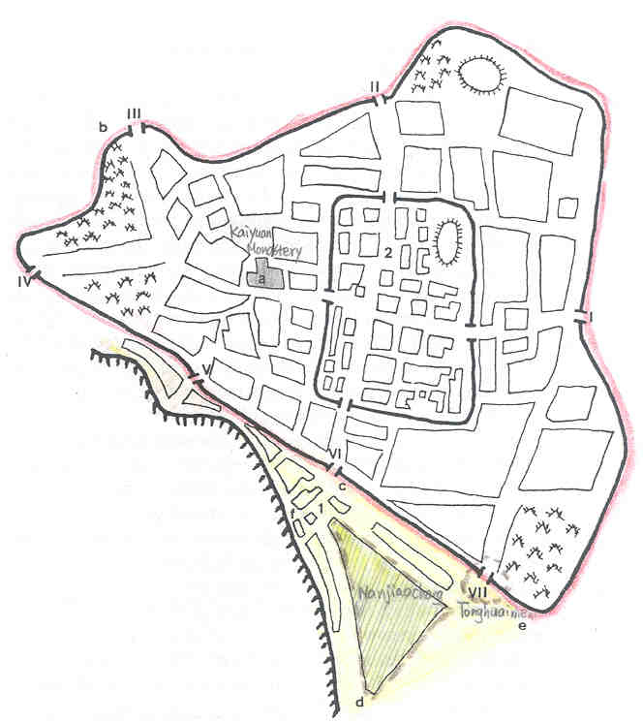
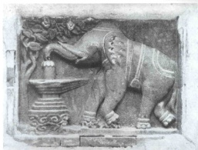
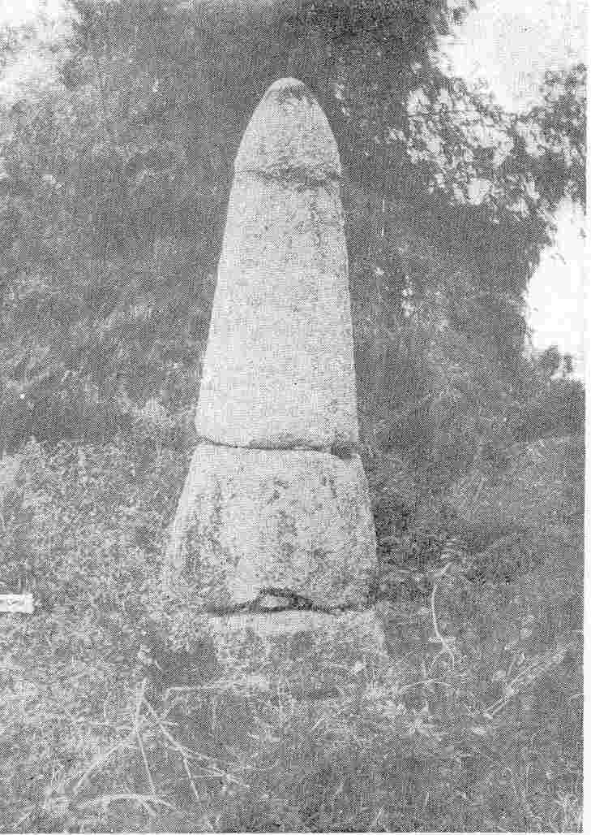
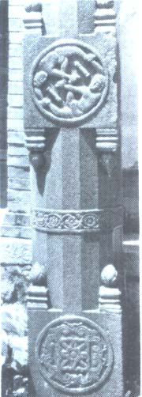
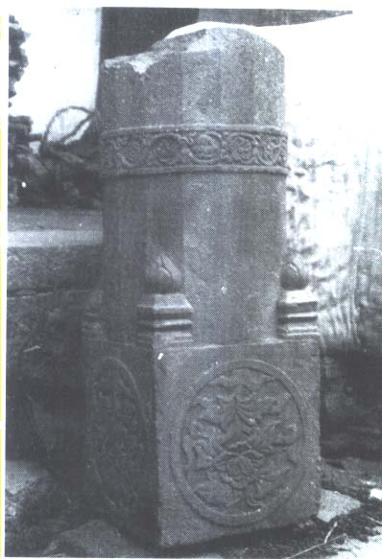
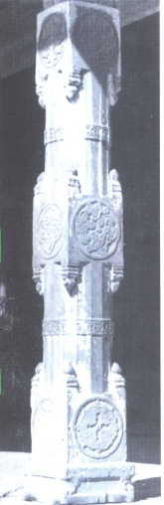
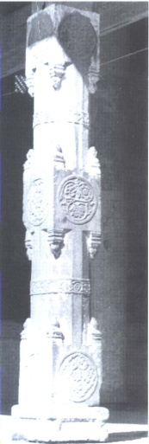
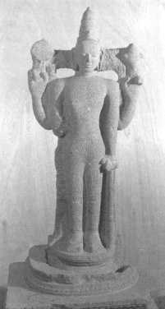
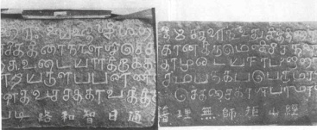
Locations of Brahmanical elements found in Quanzhou
白狗廟
開元寺
石筍
通淮門
天妃廟
南教場

Slide 6
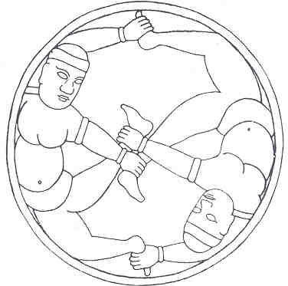
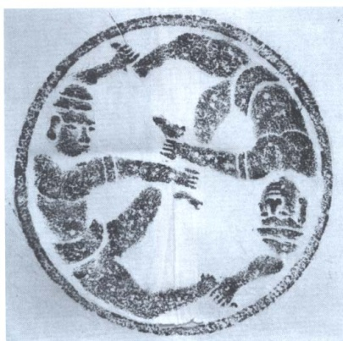
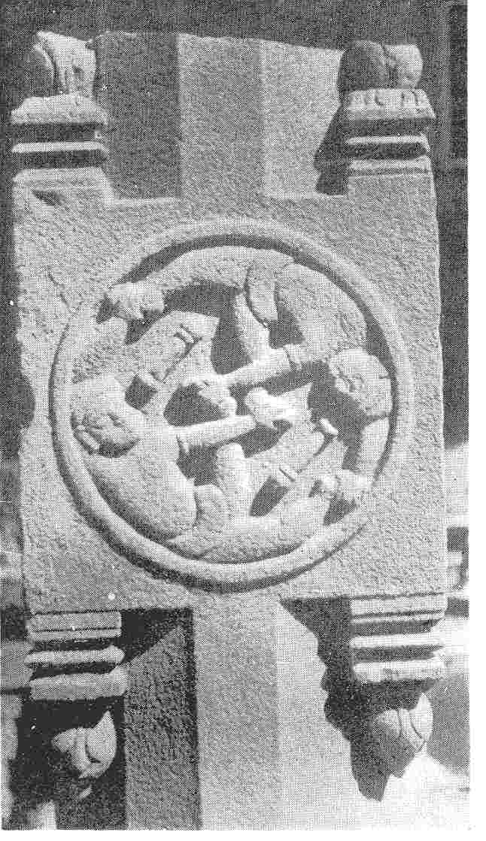
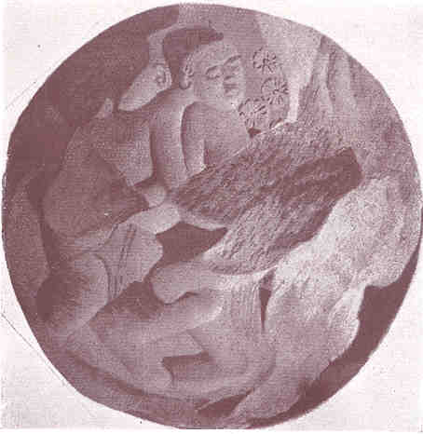
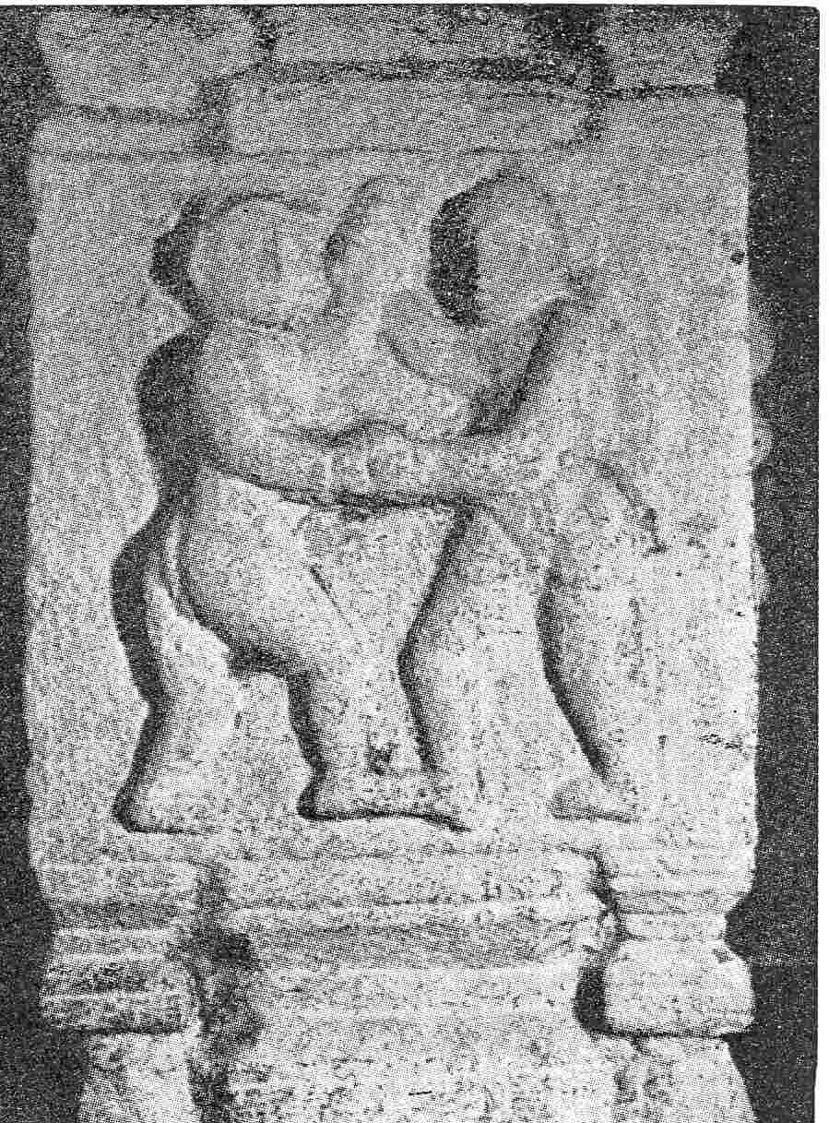
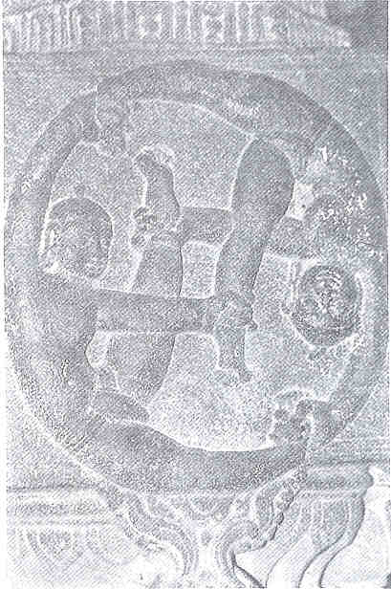
Methodology: Trust your eyes– Images Comparison
Comparison between pieces in Quanzhou and with images in South and Southeast Asia
Example image: two wrestlers (Krsna and Cāṇūra) holding each other’s hands and feet as swastika-wise
(1) and (2) found in the pillar of Kaiyuan Monastery (3) two wrestlers with short bars on a pillar unearthed from the city gate of Quanzhou (Ref. Wu Wenliang, 1957: 117, Wu Wenliang, 2005: 460, 465)
(4) Bharhut Mahastūpa (3rd century B.C.), India (5) Airavatesvara temple at Darasarum (1050-73), India (6) Manumasiddhēśvara Temple (the second half of the thirteenth century), Krishnapatnam, India
(Ref. Alexander Cunningham,1879: 35, C. Krishna Murthy (1985), plate 42, V. K. Mohan (1996), plate 114)

Slide 7
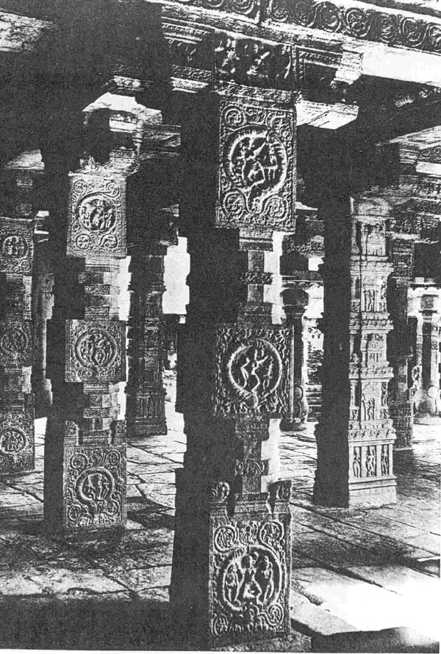
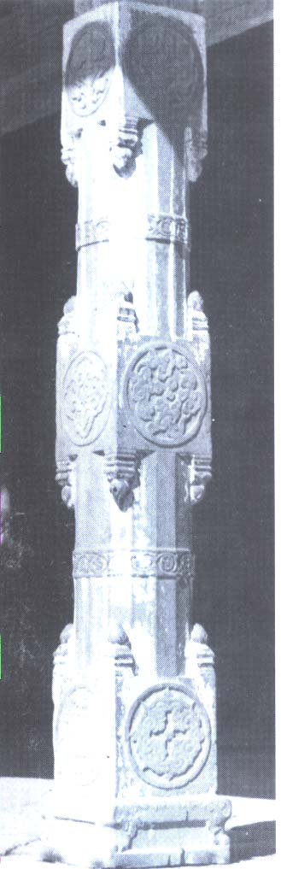
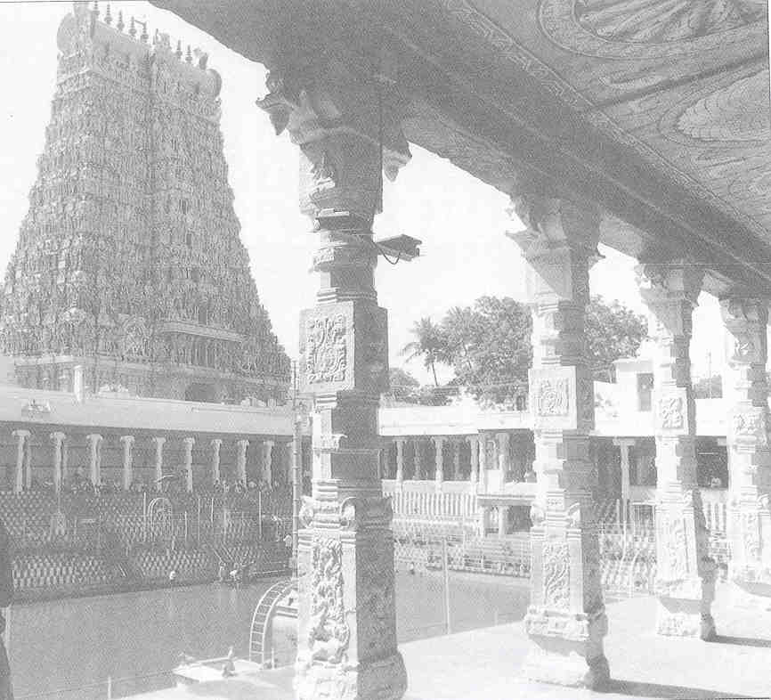
Finding: most close to many temples in Tamil Nadu of India and a temple at Polonnāvuram in Ceylon in Chola period (846-1279)
(5)
(1)
(2)
Temples in India
(5) Airavatesvara temple (6) Meenakshi temple, Madurai
(6)
16 sided columns in Quanzhou
(1) Kaiyuan Monastery (2) Tianfei temple
(3) (4) Tonghuai gate
(3) (4)

Slide 8
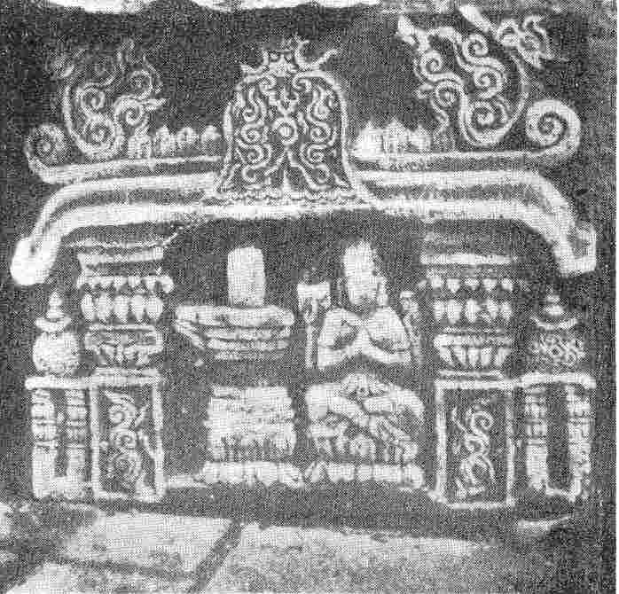
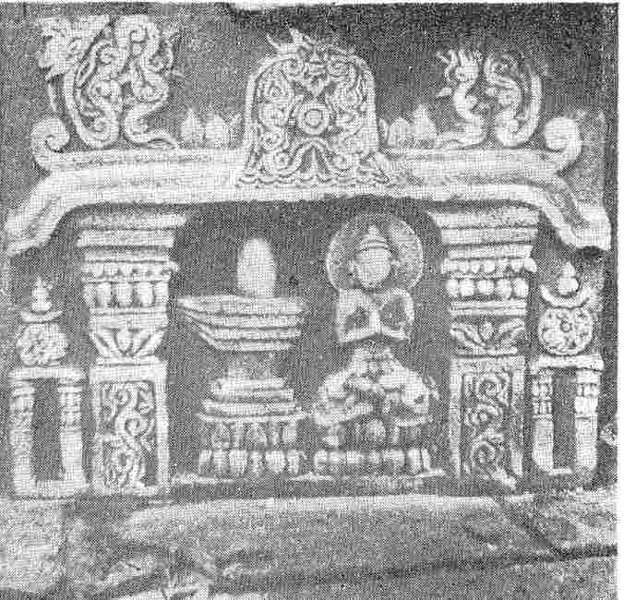
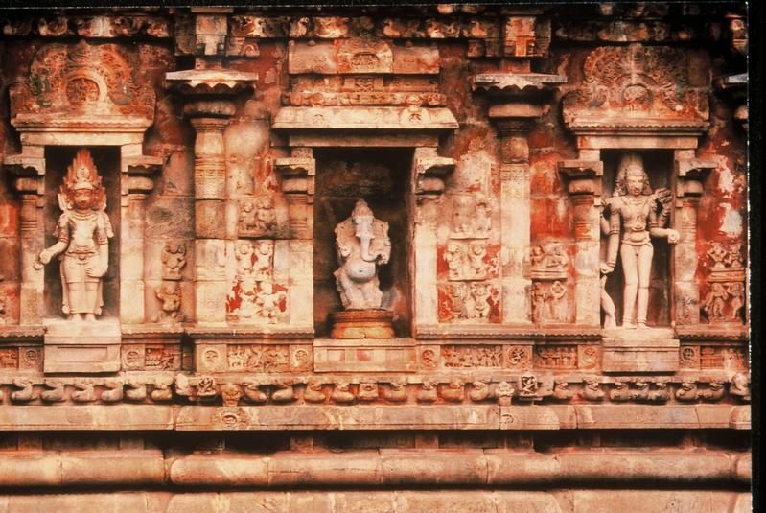
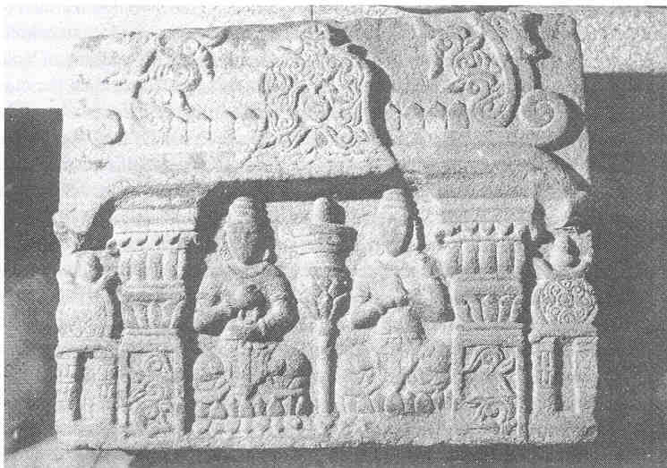
Four reliefs found in Quanzhou can’t find similar images but apparently adopted Hindu temple vocabulary (each looks like a small shrine or a sketch of an Indian temple)

Slide 9
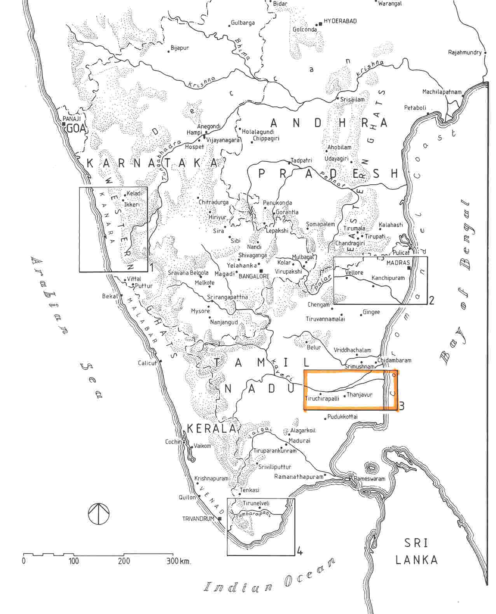
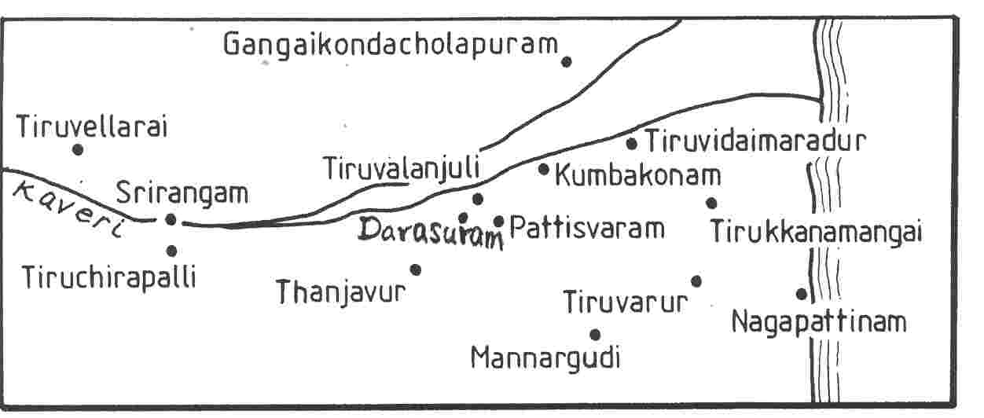
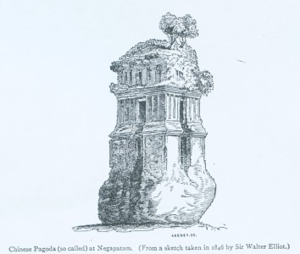
Map of India (left) and Kaveri River Region (right)
Seaport 八丹 (in 島夷志略)

Slide 10
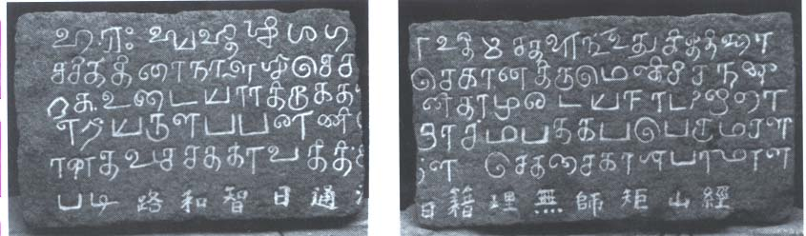
“Obeisance to Hara (Śiva). Let there be prosperity! On the day (having) the Chitrā (asterism) in the month of Chittirai of the Śaka Year 1203 (April 5, 1281), the Tavachehakkaravarttigaļ alias Sambandhap-perumāļ caused, in accordance with the firman of Chekachai-Khān, to be graciously installed the God Udaiyār Tirukkadalīśvaram Udaiya-nāyinār, for the welfare of the illustrious body of the illustrious Chekachai Khān.” According to Subrahmaniam, the temple was dedicated to Śiva by the Mongolian King Chekachai-Khān, who might be Kublai Khan (1215-1294, reigned 1264-1294) or his son Jurji.
Ref. T. N. Subrahmaniam. “A Tamil Colony in Medieval China,” in South Indian Studies, ed., R. Nagaswamy (Madras: Society for Archaeological, Historical and Epigraphical Research, 1978), p. 8.
Chinese: mistaken by early scholarship

Slide 11
Main Resources:
1. General history and historic records: 中研院漢籍電子文獻, 電子佛典協會 (Chinese Buddhist Electronic Texts), 中國佛寺志, 方志等
2. Related books and articles through UPENN library and its E-Resources (subscribers only):
Bibliography of Asian Studies, Grove Art (Oxford Art Online)
3. Google Scholar
4. ProQuest (Ann Arbor) - Ph.D. Dissertations and Master Theses
5. Image comparison: published books, Fine Arts Image Collection (UPenn), South Asian
library image collections (search through photo piles- categorized by Periods and Sites)
6. Huntington Art Archive (search or browse by Iconography, Original Location, Current Location, Material, Dynasty/Period, Religious Category)
7. UNESCO World Heritage - http://whc.unesco.org/pg.cfm?cid=31&id_site=250
The lost wax process - http://www.asia.si.edu/exhibitions/online/chola/chola.htm

Slide 12
Issues on image search:
1. Spelling confusion:
This research encounters mainly Chinese (pinyin, Wales-Giles) and Indian (Hindi, Sanskrit and Bali)
Example: Chola or Cola, Quanzhou or Chuen-chou
2. Image quality
Resolution, Color, Material, etc
3. References
Missing, Misleading, Mistaken

Slide 13
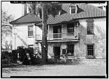
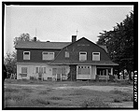
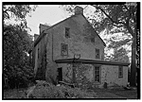
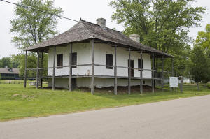
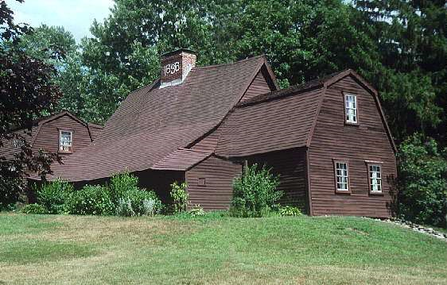
Example 2. Pre-Modernism American Architecture History
Colonial Period:
(1) Spanish Colonial
(2) Dutch Colonial
3. German/Swiss Colonial
Ximenez-Fatio House, 22 Aviles Street, Saint Augustine, FL
Ira H. Brooks House, Fresno, CA
Knapp Farm, Montgomeryville, PA
(4) French Colonial
(5) Early English Colonial
Bequette-Ribault House, Ste. Geneviève, Missouri, 1778 (left)
Fairbanks House, Dedham, MA, 1636 (right)

Slide 14
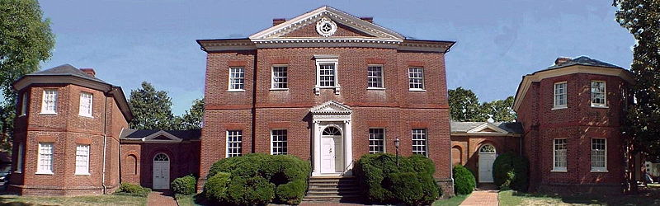
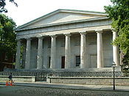
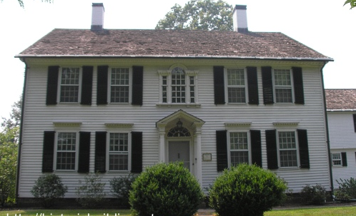
Georgian Era:
Georgian
Hammond-Harwood House, Annapolis, ML, 1774
Federal
Greek Revival
Kellogg-Eddy House, Newington, CT, 1808
Second Bank of US, Philadelphia, PA, 1824

Slide 15
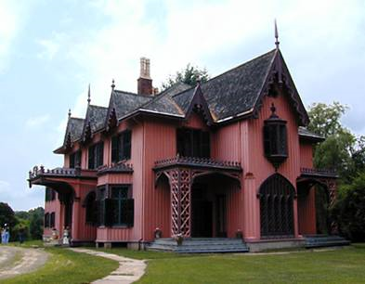
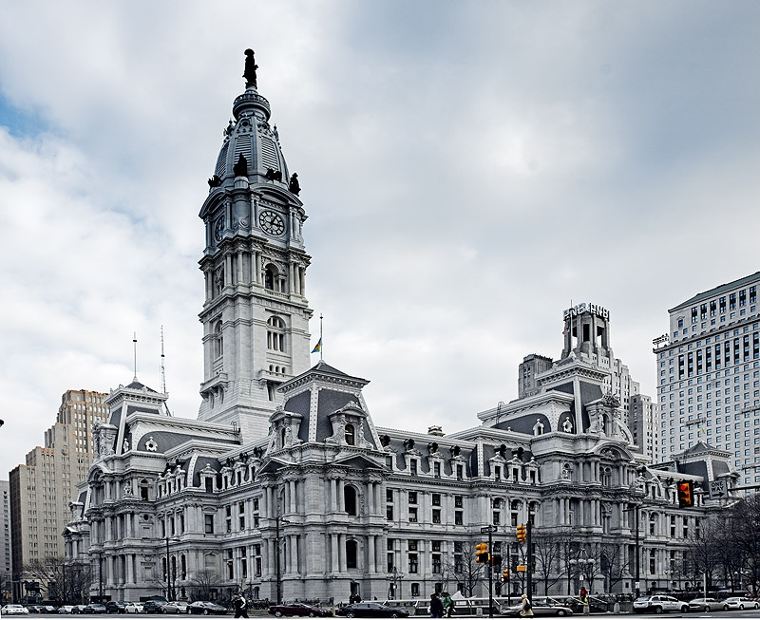




Victorian Era:
Gothic Revival
Italianate
Second Empire
Cape May, NJ
Woodstock, CT. Bowen House, 1846
Philadelphia City Hall, 1871-1901
Queen Ann
Stick
Shingle
Galveston, TX
Queen’s University, CA
Charles Lang Freer House, Detroit MI, 1890

Slide 16





Revivals: Colonial, Renaissance, Egyptian, Tudor Revival
George Felpel House, Claverack,
New York, 1920s
“La Loma de los Vientos”, Newhall, CA, 1924-8
The Breakers, Newport,
Rhode Island, 1893
Medical College of Virginia, 1845
George W. Maher building in Gary, IN, 1921

Slide 17




Classicalism
Romanesques Revival
Beaux-Arts
Trinity Church, Boston, MA (1872)
Crane Library, Quincy, MA, 1881
Metropolitan Museum of Art, NY,1902
Pennsylvania Station, NY, 1910
Demolished 1964

Slide 18






New American Visions:
Prairie School and Frank Lloyd Wright
Frank Thomas House, Oak Park, IL, 1901
Fallingwater, Bear Run, PA, 1937
Bungalows
Pasadena, CA. Gamble House, 1908
Long Beach, CA
San Antonio, TX

Slide 19

Web Resources on American architecture
1. Library of Congress: Prints & Photographs Online Catalog
Historic American Buildings Survey/Historic American Engineering Record/Historic American Landscapes Survey– more than 556,900 measured drawings, large-format photographs, and written histories for more than 38,600 historic structures and sites dating from Pre-Columbian times to the twentieth century
(1) HABS (Historic American Buildings Survey), 1933- Charles Peterson’s project
(2) HAER (Historic American Engineering Record), 1969- document US engineering and industrial structures
(3) HALS (Historic American Landscape Survey), 2000- address the recording landscape important to heritage
(4) HABS (28,824 structures) and HAER (7,061 structures), 2003
2. National Historic Landmark Program
3. Fine Arts Library Image Collection
University of Pennsylvania
4. University websites and Foundations
(ex. Wright Foundation)
5. Commercial websites: for example - www.greatbuildings.com (including 3-D models)

Slide 20

Issues and Conclusions:
1. Research Index: spelling confusion, keywords (good research system)
2. Reference: all images need to specify reference
3. Information Collaboration:
(1) Drawings, Photos, 3-D models, etc
(2) Collaboration between different collections/databases?
(3) Chinese architecture– compare to other cultures, its digital resource is limited
4. Copyright and Fair-use policy

